Slide 1
Mobile Gaming Data Analysis
Thomas Karlo Blanco
4/11/2022

Slide 2
Question #1:
Using the daily iOS revenue and download data for Township, what is the relationship between changes in downloads and changes and revenue for the app over the past three years? For example, when downloads increase, does revenue increase? If so, by how much and how soon afterward? What about when downloads decrease? *

Slide 3
Data Cleaning / Processing steps:
Create copy of township daily iOS sheet (to save a copy of the raw data)
Delete rows 1-7
Change date format from general to short date
Requirement was to look into past 3 years data, thus we’ll limit our data starting at Jan 2019
Delete data before 2019
Delete Android columns
Delete “Unified rows” as they don’t have data
Create new column: “Total iOS downloads”
This is combined iOS & iPhone downloads
Create new column: “Total Revenue”
This is combined iOS & iPhone revenue
Create pivot table to show qtr and monthly data across the 3 years timespan, copy to new sheet

Slide 4
Chart 1:
* Combined iPad & iPhone data

Slide 5
Chart 2:
* Combined iPad & iPhone data

Slide 6
Chart 3:
* Combined iPad & iPhone data

Slide 7
Insights for Question #1:
We are seeing positive correlation between delta in downloads and revenue
There is significant increase in revenue when downloads increase
This is evident on 3 cases:
1) 2019 Q1 to Q3 downloads increase from 887.3k to 1.3M (457k increase), which caused an increase in revenue from $8.4M to $12.3M ($3.8M increase)
2) 2020 Q1 to Q2 downloads increase from 565k to 1.08M (515k increase), which caused an increase in revenue from $10.9M to $14.8M ($3.85M increase)
3) 2021 Q1 to Q4 downloads increase from 262k to 892.7k (630.4k increase), which caused an increase in revenue from $13.3M to $19.4M ($6.1M increase)
With these cases we are seeing an average of $8.60 increase in revenue for each increase in download
Looking at the monthly revenue trend, most of the time, the revenue would increase at the same time with downloads, but there are cases that it would carry over to the next month.

Slide 8
Insights for Question #1:
In terms of decreasing downloads, revenue also decreases but not as drastic.
This is evident on these 2 cases:
1) 2019 Q3 to 2020 Q1 downloads decrease from 1.34M to 565k (778.7k decrease), which caused a decrease in revenue from $12.3M to $10.9M ($1.33M decrease)
2) 2020 Q2 to 2021 Q1 downloads decrease from 1.08M to 262k (818.8k decrease), which caused an increase in revenue from $14.8M to $14.5M ($1.5M decrease)
With these cases we are seeing an average of $1.77 decrease in revenue for each decrease in download

Slide 9
Question #2:
Looking at the revenue impacts for events in the core market in the past year, what event type with more than 100 releases had the highest and most consistent revenue impact? Why? *

Slide 10
Data Cleaning / Processing steps:
Copy “Core event..” sheet (to save a copy of the raw data)
Limit data to past year only (starting Jan 2021), but oldest available data is Sept 2021, so all data available is relevant
Create pivot table to check number of releases per event type
Include the following stats per event type on revenue impact:
Mean
StdDev
Var
Min
Max
Transfer final pivot table to new sheet
Export data to Tableau for other Data Visualizations

Slide 11
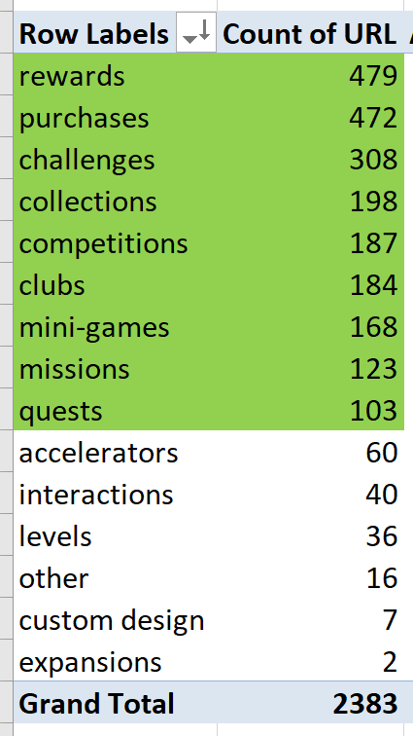
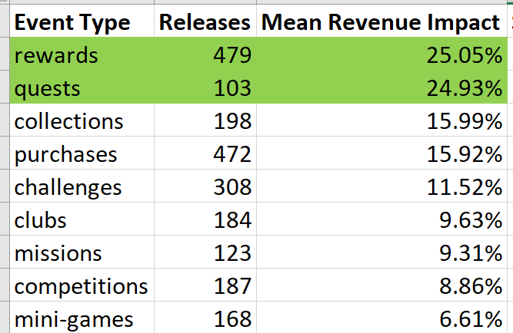
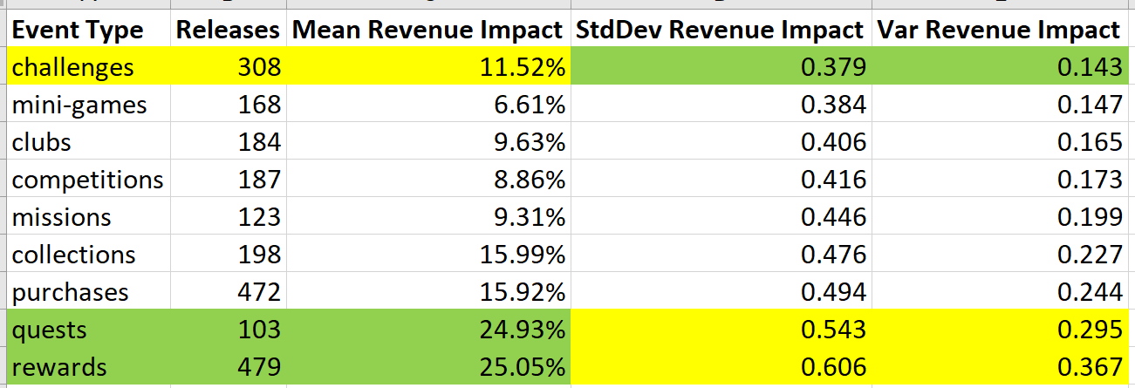
Stats Summary for events:
1) Here are the events highlighted in green are the ones that has greater than 100 releases
2) In terms of mean revenue impact, rewards are on top with 25.05%, followed closely by quests at 24.93%
3) Challenges had the least standard deviation & variance, but is lower in terms of mean revenue impact

Slide 12
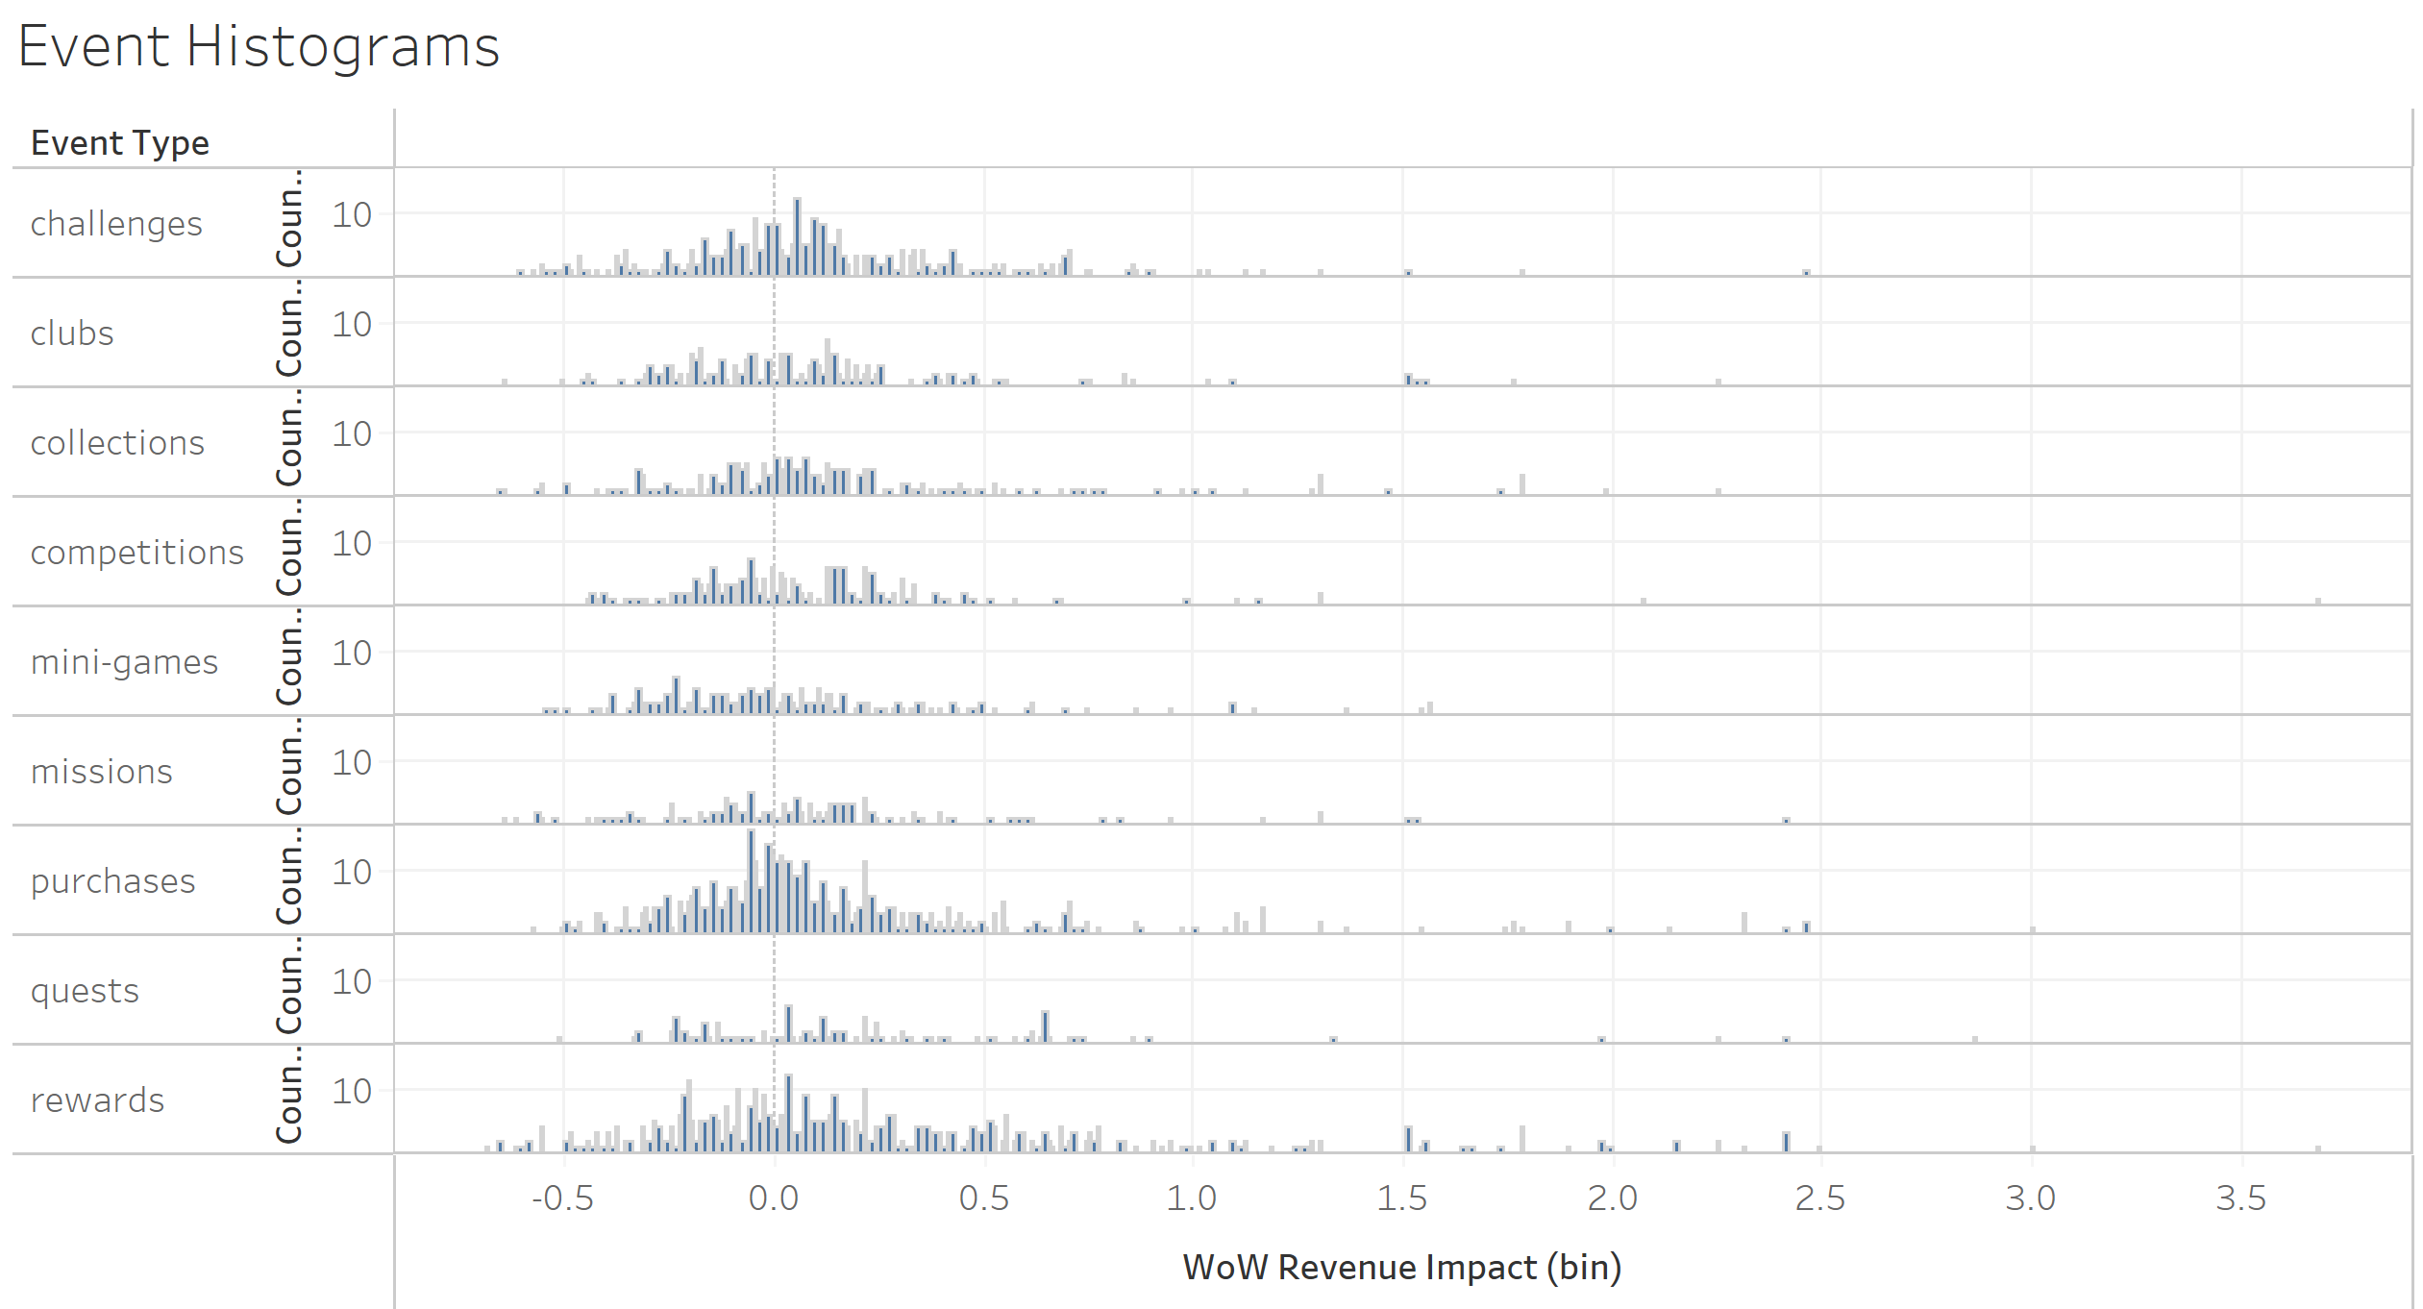
- Used Tableau to plot the histograms of events with greater than 100 releases
- Looking at the histograms, Challenges & Rewards are the top choices as their central tendencies are evidently positive
The high standard deviation of Rewards is also noticeable on this chart. This is evidence that the extremely high Revenue impact cases (>100%) are pulling its mean higher.
Quests would seem to be a good choice here but it not that evident due to lower release count than others.

Slide 13
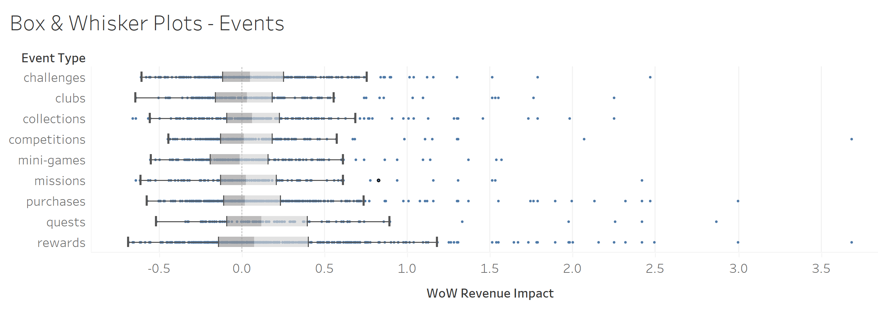
- Used Tableau to plot the box charts of events with greater than 100 releases
Looking at the box plots, good options are, Quests, Rewards, Collections & Challenges
Based on this chart, the best choice would be “Quests” because it has the highest median.
And even though it has a wide spread, it is towards the positive side, which is desirable.
In summary, we’ll opt with “Quests” as the best option for events, with the following reasons:
The 2nd highest average (very close to “Rewards”, by only 0.12%)
Slightly better standard deviation & variance than “Rewards”
The highest median of all the events.

Slide 14
Question #3:
Using the event type you identified in question 2, on which day of the week do new releases of this kind of event perform best and most consistently? *

Slide 15
Data Cleaning / Processing steps:
Create new column on copied “core event..” sheet, titled “day of the week”
Used “Text” function to output day of the week based on release date
Created new pivot table with new “day of the week” column

Slide 16
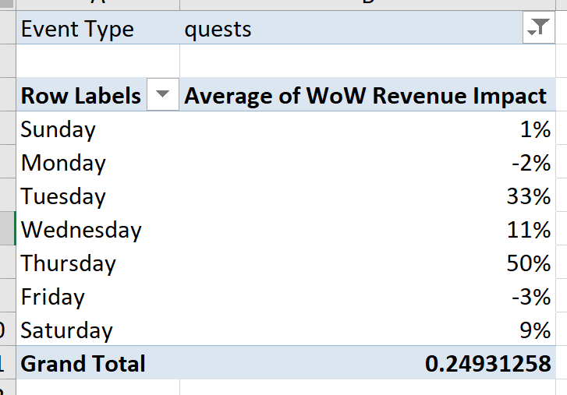
Insight for Question #3:
Based on historical data, it is best to release quests during Thursdays

